Slide 1
Topic 4 Energy Introduction
Thermodynamics: An Engineering Approach
8th Edition Yunus A. Çengel, Michael A. Boles
McGraw-Hill, 2015

Slide 2
Objectives
Introduce the concept of energy and define its various forms.
Discuss the nature of internal energy.
Define specific heat and demonstrate properties for various substances.
Show relationships between internal energy, enthalpy, and specific heat.

Slide 3
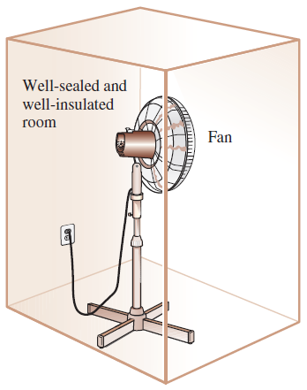
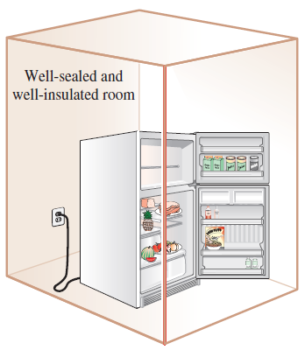
INTRODUCTION
If we take the entire room—including the air and the refrigerator (or fan)—as the system, which is an adiabatic closed system since the room is well-sealed and well-insulated, the only energy interaction involved is the electrical energy crossing the system boundary and entering the room.
As a result of the conversion of electric energy consumed by the device to heat, the room temperature will rise.
A fan running in a well-sealed and well-insulated room will raise the temperature of air in the room.
A refrigerator operating with its door open in a well-sealed and well-insulated room

Slide 4
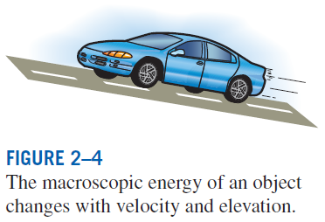
FORMS OF ENERGY
Energy can exist in numerous forms such as thermal, mechanical, kinetic, potential, electric, magnetic, chemical, and nuclear, and their sum constitutes the total energy, E of a system.
Thermodynamics deals only with the change of the total energy.
Macroscopic forms of energy: Those a system possesses as a whole with respect to some outside reference frame, such as kinetic and potential energies.
Microscopic forms of energy: Those related to the molecular structure of a system and the degree of the molecular activity.
Internal energy, U: The sum of all the microscopic forms of energy.
Kinetic energy, KE: The energy that a system possesses as a result of its motion relative to some reference frame.
Potential energy, PE: The energy that a system possesses as a result of its elevation in a gravitational field.

Slide 5
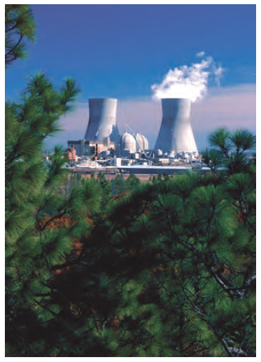

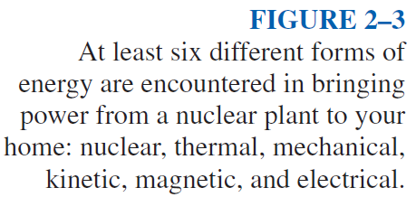

Slide 6
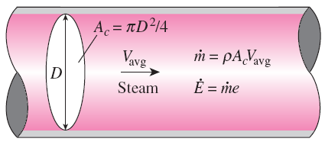

Kinetic energy
Kinetic energy per unit mass
Mass flow rate
Potential energy
Potential energy per unit mass
Energy flow rate
Total energy of a system
Energy of a system per unit mass
Total energy per unit mass

Slide 7
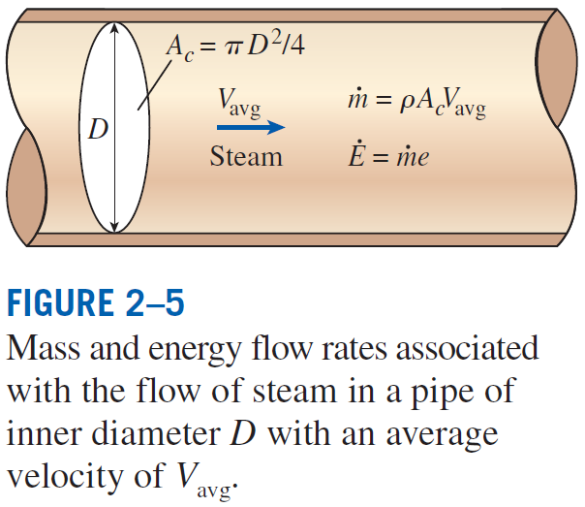

Slide 8
Example Isobutane is piped through a piping network with an inside diameter of 2 in. If the volumetric flow rate at a particular point is 225 gallons per minute (gpm), what is the mass flow rate? What is the average velocity of the fluid?
Solution

Slide 9
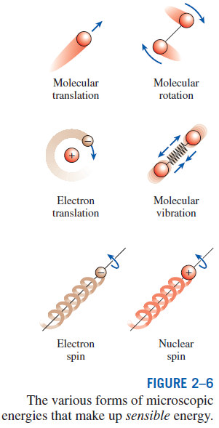
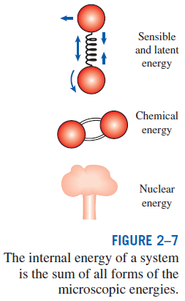
Some Physical Insight to Internal Energy
Sensible energy: The portion of the internal energy of a system associated with the kinetic energies of the molecules.
Latent energy: The internal energy associated with the phase of a system.
Chemical energy: The internal energy associated with the atomic bonds in a molecule.
Nuclear energy: The tremendous amount of energy associated with the strong bonds within the nucleus of the atom itself.
Thermal = Sensible + Latent
Internal = Sensible + Latent + Chemical + Nuclear

Slide 10
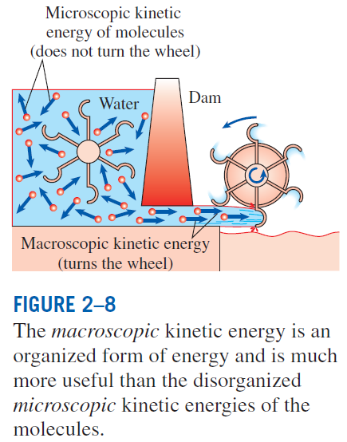
The total energy of a system, can be contained or stored in a system, and thus can be viewed as the static forms of energy.
The forms of energy not stored in a system can be viewed as the dynamic forms of energy or as energy interactions.
The dynamic forms of energy are recognized at the system boundary as they cross it, and they represent the energy gained or lost by a system during a process.
The only two forms of energy interactions associated with a closed system are heat transfer and work.
The difference between heat transfer and work: An energy interaction is heat transfer if its driving force is a temperature difference. Otherwise it is work.

Slide 11
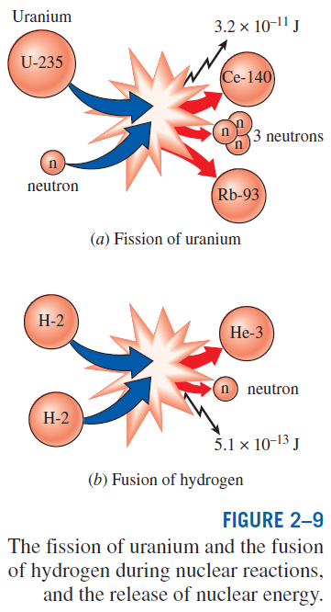
More on Nuclear Energy
The best known fission reaction involves the split of the uranium atom (the U-235 isotope) into other elements and is commonly used to generate electricity in nuclear power plants (440 of them in 2004, generating 363,000 MW worldwide), to power nuclear submarines and aircraft carriers, and even to power spacecraft as well as building nuclear bombs.
Nuclear energy by fusion is released when two small nuclei combine into a larger one.
The uncontrolled fusion reaction was achieved in the early 1950s, but all the efforts since then to achieve controlled fusion by massive lasers, powerful magnetic fields, and electric currents to generate power have failed.

Slide 12
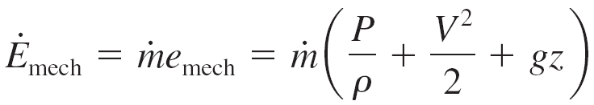
Mechanical Energy
Mechanical energy: The form of energy that can be converted to mechanical work completely and directly by an ideal mechanical device such as an ideal turbine.
Kinetic and potential energies: The familiar forms of mechanical energy.
Mechanical energy of a flowing fluid per unit mass
Rate of mechanical energy of a flowing fluid
Mechanical energy change of a fluid during incompressible flow per unit mass
Rate of mechanical energy change of a fluid during incompressible flow

Slide 13
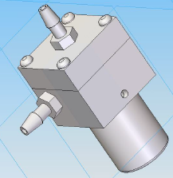
Example Determine the mechanical work the pump imparts to the water.
D₂ = 1 cm
Solution
Assume z₁ ≈ z₂
P₂ = 200 Pa
D₁ = 3 cm
Water
500 g/s
P₁ = 100 Pa

Slide 14
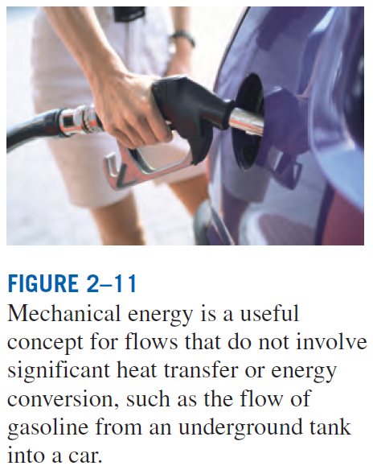

Slide 15
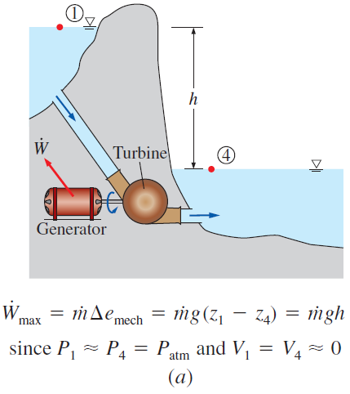
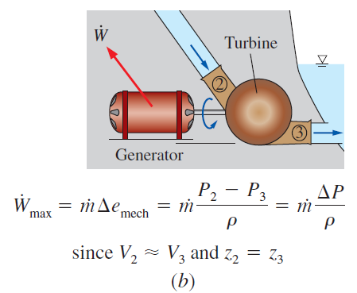
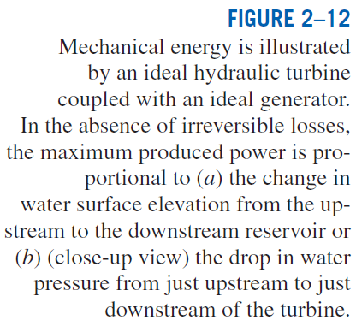

Slide 16
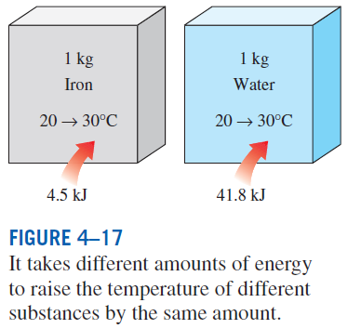
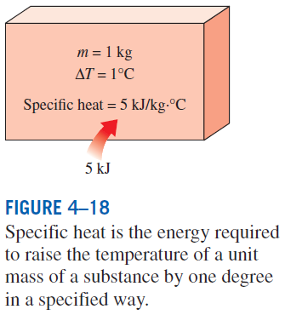
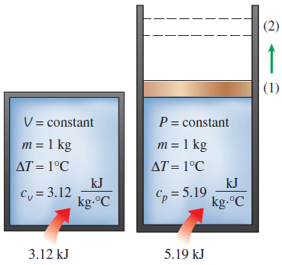
SPECIFIC HEATS
Specific heat at constant volume, c_{v}: The energy required to raise the temperature of the unit mass of a substance by one degree as the volume is maintained constant.
Specific heat at constant pressure, c_{p}: The energy required to raise the temperature of the unit mass of a substance by one degree as the pressure is maintained constant.
Constant-volume and constant-pressure specific heats c_{v} and c_{p}
(values are for helium gas).

Slide 17
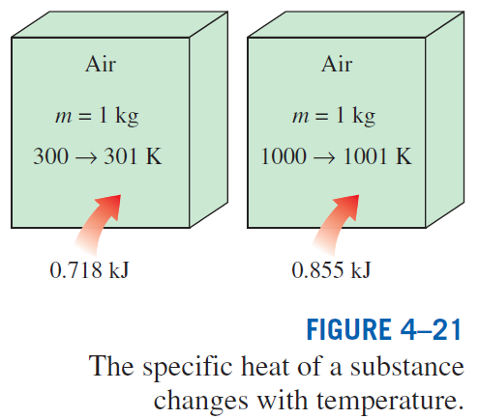
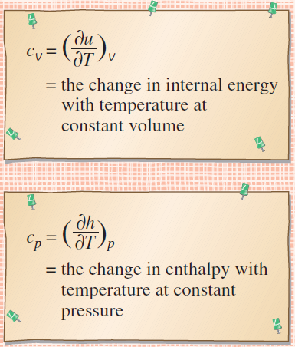
True or False?
c_{p} is always greater than c_{v}
The equations are valid for any substance undergoing any process.
c_{v} and c_{p} are properties.
c_{v} is related to the changes in internal energy and c_{p} to the changes in enthalpy.
A common unit for specific heats is kJ/kg·°C or kJ/kg·K. Are these units identical?
Formal definitions of c_{v} and c_{p}.

Slide 18
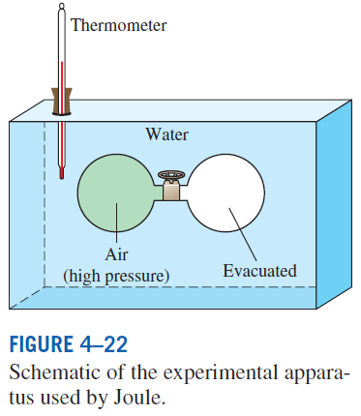

INTERNAL ENERGY, ENTHALPY, AND SPECIFIC HEATS OF IDEAL GASES
Joule showed using this experimental apparatus that u=u(T)
Internal energy and enthalpy change of an ideal gas
For ideal gases, u, h, c_{v}, and c_{p} vary with temperature only.

Slide 19
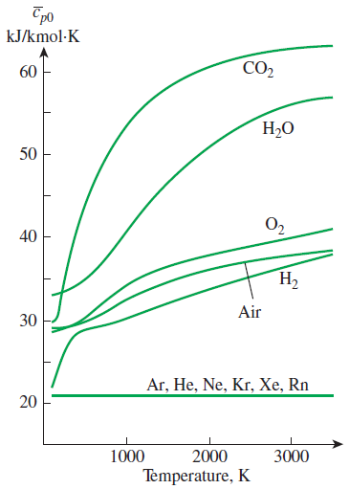
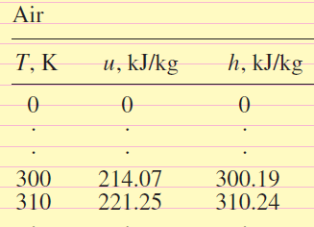
At low pressures, all real gases approach ideal-gas behavior, and therefore their specific heats depend on temperature only.
The specific heats of real gases at low pressures are called ideal-gas specific heats, or zero-pressure specific heats, and are often denoted c_{p0} and c_{v0}.
u and h data for a number of gases have been tabulated.
These tables are obtained by choosing an arbitrary reference point and performing the integrations by treating state 1 as the reference state.
Ideal-gas constant-pressure specific heats for some gases (see Table A–2c for c_{p} equations).
In the preparation of ideal-gas tables, 0 K is chosen as the reference temperature.

Slide 20
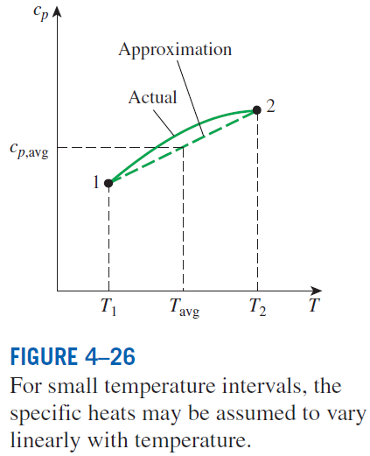
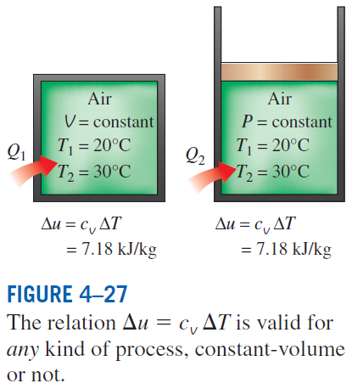
Internal energy and enthalpy change when specific heat is taken constant at an average value
(kJ/kg)

Slide 21

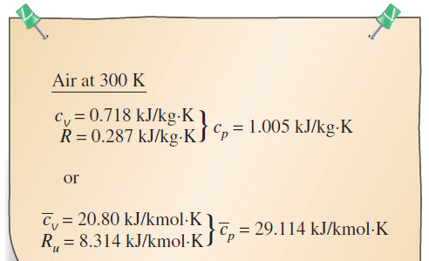
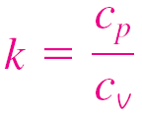
Specific Heat Relations of Ideal Gases
The relationship between c_{p}, c_{v} and R
dh = c_{p}dT and du = c_{v}dT
On a molar basis
Specific heat ratio
The specific ratio varies with temperature, but this variation is very mild.
For monatomic gases (helium, argon, etc.), its value is essentially constant at 1.667.
Many diatomic gases, including air, have a specific heat ratio of about 1.4 at room temperature.
The c_{p} of an ideal gas can be determined from a knowledge of c_{v} and R.

Slide 22
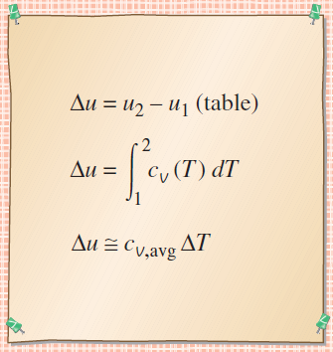
Three ways of calculating Δu and Δh
By using the tabulated u and h data. This is the easiest and most accurate way when tables are readily available.
By using the c_{v} or c_{p} relations (Table A-2c) as a function of temperature and performing the integrations. This is very inconvenient for hand calculations but quite desirable for computerized calculations. The results obtained are very accurate.
By using average specific heats. This is very simple and certainly very convenient when property tables are not available. The results obtained are reasonably accurate if the temperature interval is not very large.
Three ways of calculating Δu.

Slide 23
Evaluation of the Δu of an Ideal Gas
Air at 300 K and 200 kPa is heated at constant pressure to 600 K. Determine the change in internal energy of air per unit mass, using
data from the air table
the functional form of the specific heat
the average specific heat value
Solution

Slide 24
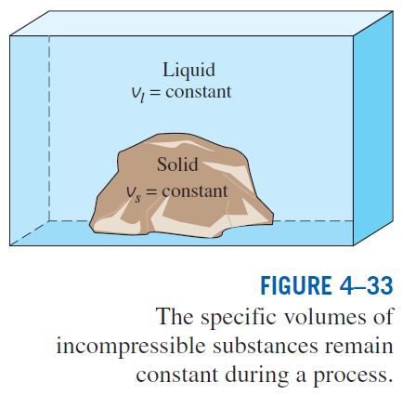
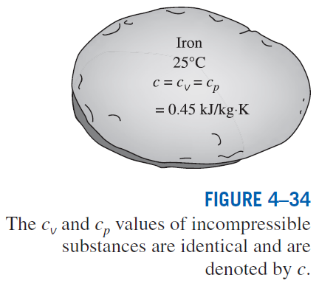
INTERNAL ENERGY, ENTHALPY, AND SPECIFIC HEATS OF SOLIDS AND LIQUIDS
Incompressible substance: A substance whose specific volume (or density) is constant. Solids and liquids are incompressible substances.

Slide 25

Internal Energy Changes
$$du= c_{v}dT=c\left(T\right)dT$$
$$∆u= u_{2}−u_{1}=\int_{1}^{2}{c\left(T\right)dT}$$
For small temperature intervals:
$$∆u ≅c_{avg}\left(T_{2}−T_{1}\right)$$

Slide 26
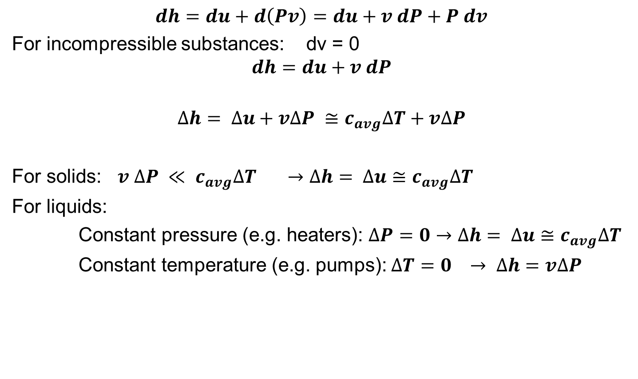
Enthalpy Changes
$$dh=du+d\left(Pv\right)=du+v dP+P dv$$
For incompressible substances: dv = 0
$$dh=du+v dP$$
$$∆h= ∆u+v∆P ≅c_{avg}∆T+v∆P$$
For solids: $v ∆P ≪ c_{avg}∆T →∆h= ∆u≅c_{avg}∆T$
For liquids:
Constant pressure (e.g. heaters): $∆P=0→∆h= ∆u≅c_{avg}∆T$
Constant temperature (e.g. pumps): $∆T=0 → ∆h=v∆P$

Slide 27
Cooling of an Iron Block by Water
A 50-kg iron block at 80ºC is dropped into an insulated tank that contains 0.5 m³ of liquid water at 25ºC. Determine the temperature when thermal equilibrium is reached.
Hint: For thermal equilibrium to be reached, the sum of the changes of internal energy of the iron block and water must be equal to zero.
Solution

Slide 28
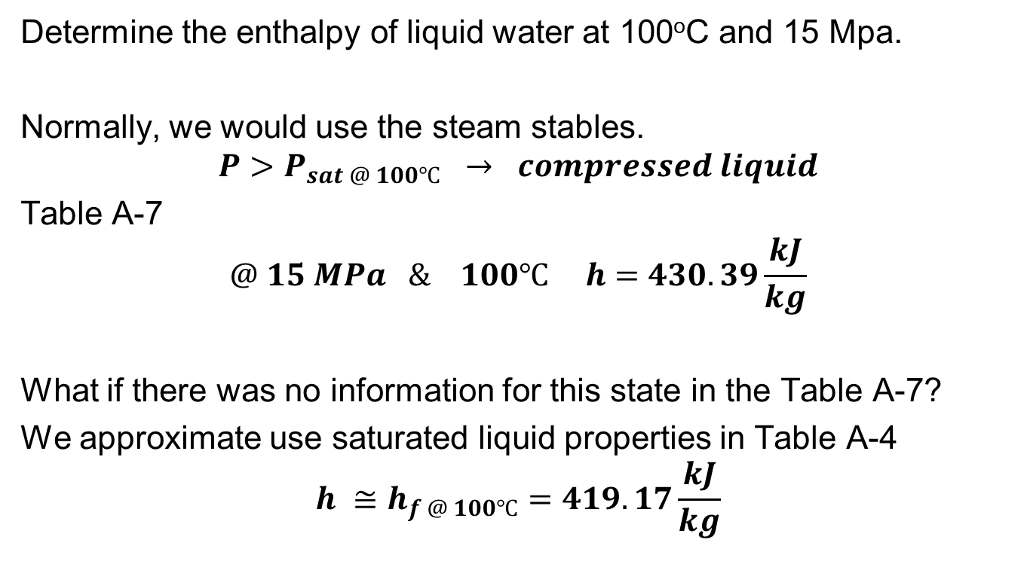
Enthalpy of a Compressed Liquid
Determine the enthalpy of liquid water at 100ºC and 15 Mpa.
Normally, we would use the steam stables.
$$P>P_{sat @ 100℃} → compressed liquid$$
Table A-7
$$@ 15 MPa \& 100℃ h=430.39\frac{kJ}{kg}$$
What if there was no information for this state in the Table A-7?
We approximate use saturated liquid properties in Table A-4
$$h ≅h_{f @ 100℃}=419.17\frac{kJ}{kg}$$

Slide 29
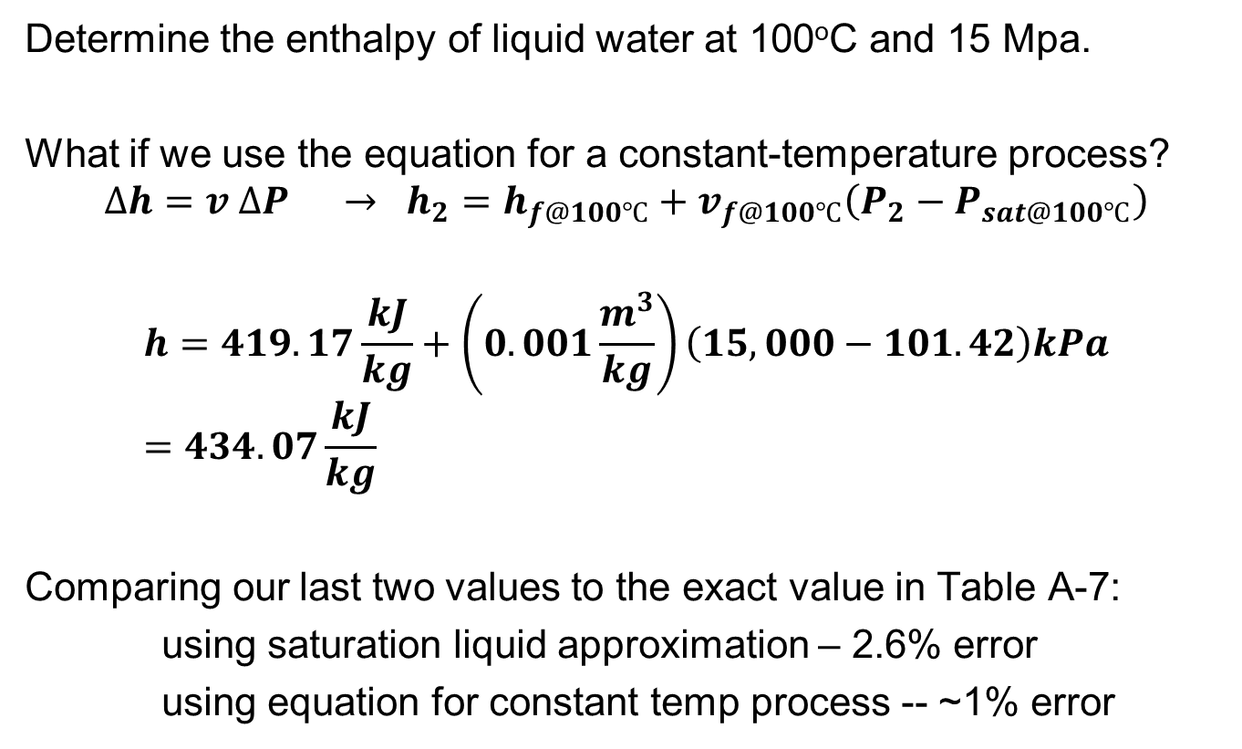
Enthalpy of a Compressed Liquid
Determine the enthalpy of liquid water at 100ºC and 15 Mpa.
What if we use the equation for a constant-temperature process?
$$∆h=v ∆P → h_{2}=h_{f@100℃}+v_{f@100℃}\left(P_{2}−P_{sat@100℃}\right)$$
$$h=419.17\frac{kJ}{kg}+\left(0.001\frac{m^{3}}{kg}\right)\left(15,000−101.42\right)kPa=434.07\frac{kJ}{kg}$$
Comparing our last two values to the exact value in Table A-7:
using saturation liquid approximation – 2.6% error
using equation for constant temp process -- ~1% error

Slide 30
Summary
Forms of energy
Macroscopic = kinetic + potential
Microscopic = Internal energy (sensible + latent + chemical + nuclear)
Specific heats
Constant-pressure specific heat, c_{p}
Constant-volume specific heat, c_{v}
Internal energy, enthalpy, and specific heats of ideal gases
Specific heat relations of ideal gases
Internal energy, enthalpy, and specific heats of incompressible substances (solids and liquids)

